Slide 1
Lecture 1: Introduction

Slide 2
Optimization problem/program
objective
“minimize”
domain
“subject to”

Slide 3


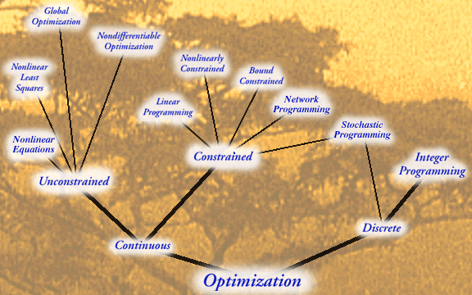
Optimization “tree”
Source: NEOS optimization guide
Notes:
Not really a tree (as you can see with Stochastic programming). Some tools are more universal than others and can handle different tasks.
Quite often we cannot solve the problem exactly, and in any case different methods take different amount of time (and require different amount of fine-tuning).
So for each problem, there are typically several methods, and some are better than others.
As a rule of thumb, the more universal the method, the worse it is for a specific problem

Slide 4
This class (a one slide overview)
Problem
What are the standard tools?
How to build more powerful tools?
How to map real problems to optimization?
Notes:
The pipeline is not so straight-forward/feed-forward
The arsenal of the available tools affects our mapping. Some mappings are very straighforward but lead to optimization programs that we cannot solve well. Then we have to compromise (use programs which do not reflect our real-life problem perfectly, but are solvable with our tools).

Slide 5
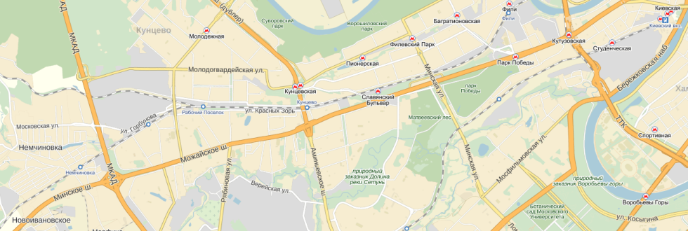
Planning the bus stop
Where should Skoltech place the shuttle stop for its MS students?
Potential factors to consider:
Where do students live?
Whether it is possible/convenient to use certain places as a stop?
Commute distance from the stop to Skoltech.

Slide 6
Planning the bus stop
Where should Skoltech place the shuttle stop for its MS students?
Steps for a principled solution:
Model each factor with a feasibility function of x (where x is a position of the stop).
Optimize the sum of the factors (easy in this case – exhaustive search).

Slide 7
Planning the bus stop
Steps for a principled solution:
Model each factor with a feasibility function of x (where x is a position of the stop).
Optimize the sum of the factors (easy in this case – exhaustive search).

Slide 8
Opening two stops

Slide 9
Opening two stops
Getting on the further of the two stops incurs further time penalty. How to model this?

Slide 10
What about more stops?
From a certain number, exhaustive search becomes infeasible
What about making the number of stops part of optimization?

Slide 11
Different modeling approach
fixed candidate locations of the stops
fixed locations of the students
should we open the stop?
which stop should the student use?

Slide 12
Different modeling approach
An instance of the facility location problem

Slide 13
What do we want from the modeling step?
The objective function should reflect the task we are facing (not at all trivial!)
The domain must exclude unacceptable solutions (especially those with the low objective) and include all acceptable solutions (especially those with low objective)
The resulting formulation (the program) should be amenable for the efficient optimization
Quite often, we have to seek trade-off between 1+2 and 3

Slide 14
Evaluating the function
Main assumption:
We can evaluate
We can check if a point is within the domain
Common additional assumptions:
We can evaluate first-order derivatives
We can evaluate second-order derivatives

Slide 15
What do we want from an optimization algorithm?
Ideally, we want all global minima
Well, maybe at least one
Examples of functions with multiple global minima
Definition: is a global minimum, if
Notes:
In most applications, we just care about a good value. In some cases, we must know that some values do not exist

Slide 16
Local minima
In many cases, finding a global minimum is not possible.
Typically, we should still be able to find a local minimum
Definition: is a local minimum, if
(D must be a topological space)
Sometimes (non-smooth, high dimensional functions, complex domains), even getting to a local minimum is hard

Slide 17
Topological space (from Wikipedia)
Let X be a set; the elements of X are usually called points, though they can be any mathematical object. Let N be a function assigning to each x (point) in X a non-empty collection N(x) of subsets of X. The elements of N(x) will be called neighbourhoods of x with respect to N (or, simply, neighbourhoods of x). The function N is called a neighbourhood topology if the axioms below are satisfied; and then X with N is called a topological space.
If N is a neighbourhood of x (i.e., N ∈ N(x)), then x ∈ N. In other words, each point belongs to every one of its neighbourhoods.
If N is a subset of X and contains a neighbourhood of x, then N is a neighbourhood of x. I.e., every superset of a neighbourhood of a point x in X is again a neighbourhood of x.
The intersection of two neighbourhoods of x is a neighbourhood of x.
Any neighbourhood N of x contains a neighbourhood M of x such that N is a neighbourhood of each point of M.

Slide 18
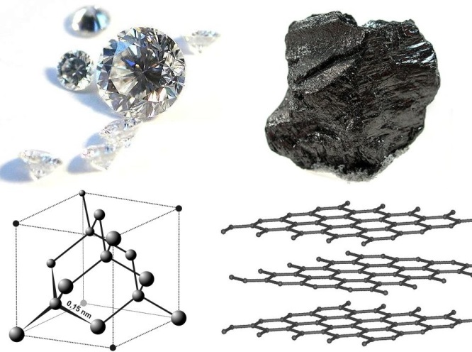
Local minima in nature
Image from Wikipedia
Local minimum
Global minimum

Slide 19
How to check that we are at local minimum?
Assume:
There are no constraints
The domain is continuous
The objective is smooth
Taylor expansion:

Slide 20
How to check that we are at local minimum?
Taylor expansion:
Necessary condition (for to be a local minimum):
Proof (idea): assume converse, let
Thus, for small enough

Slide 21
1D example

Slide 22
Gradient descent
(Our first optimization algorithm)
x = x₀
γ = 0.001
while
In practice, a care should be taken to adjust
More on unconstrained optimization in week 4

Slide 23
1D example

Slide 24
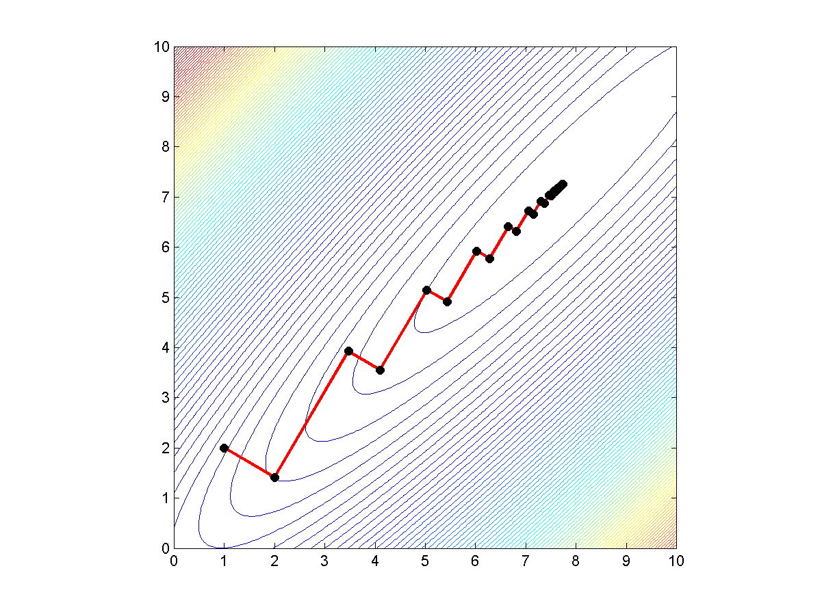
2D example

Slide 25
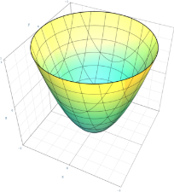
Checking for globality
Assume, we are at a local minimum.
How do we know, it is global?
Generally, this is not possible, unless the problem has some special structure
Most important case, when we know that we are at global minimum, is when the domain and the objective are convex
More on convexity later in Week 5

Slide 26
Minimization vs. Maximization
Maximization is trivially reduced to minimization
We will tend to discuss minimization, but it will all be applicable to maximization

Slide 27
Course schedule
Week 1 | Local opt, DynProg | Python
Week 2 | LP intro, Simplex method | CVXPY
Week 3 | Networks, Integer programs | CVXPY+ GurobiPY
Week 4 | Least sq., Unconstrained opt | SciPy. optimize
Week 5 | Convex opt, duality | CVXPY
Week 6 | Advanced | Misc
Week 7 | Project work
Week 8

Slide 28
Assignments
6 assignments, 1 per week, 70 points total
Assignments are due Wednesday, 23:59 of the next week
The deadline is hard, after deadline you get 50% of points
Submission: JohnDoe3.zip (IPython notebook or pdf + MATLAB code)

Slide 29
Collaboration policy for assignments
You are welcome to discuss lectures and general concepts
Assignments are for personal work
Do not discuss a problem until you have thought about it for at least 30 minutes
Your code must be written by you
Copying code is not allowed
It is ok to seek help with Python
…but the code and the report you submit must be yours

Slide 30
Coding
Main environment: IPython
+CVXPY (http://www.cvxpy.org/)
+SciPy.optimize
+GurobiPY (http://www.gurobi.com/)
Alternative environment: MATLAB
+CVX (http://cvxr.com/cvx/)
+MATLAB optimization toolbox
+GUROBI

Slide 31
Lectures
18 lectures, including 1 guest lecture (Panagiotis Karras) on Nov, 6th
Interactive (short exercises, discussions welcome)
2-2.5 hours
PPTX (+voiced screencast) will appear on Stellar the night after the lecture
Attendance recommended, not mandatory
No electronic devices please

Slide 32
Getting help from the team
Please use PIAZZA as much as possible! We will strive to respond quickly
Offline recitations are once a week (as scheduled). Walk-in for consultation
I will answer questions during and after lectures
Other offline consultations are by email appointment with TAs

Slide 33
Self-study
Some lectures (especially towards the second half) will follow textbooks closely
Links to textbooks and MOOCs will be provided during the lectures
Wikipedia is often quite useful

Slide 34
Projects
Group projects (ideal size 3-4)
Outcomes:
presentation
code
report
upto 30 points for each participant
You can either suggest your own topic or get one from us
Topic and groups must be selected by the end of week 5
Try to coordinate with the other class (joint project is ideal)

Slide 35
Problem: assign students to teams to projects
Optimize assigning students to teams, and teams to projects
Things to consider:
Preferences
Each team should have enough coding experience close to average over all students
Team size 3 or 4
0-2 teams per project
Write it as an optimization program
All your variables must be binary!

